Slide 1
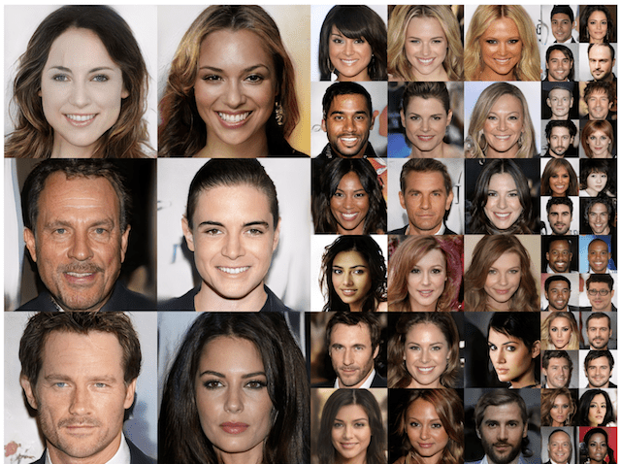
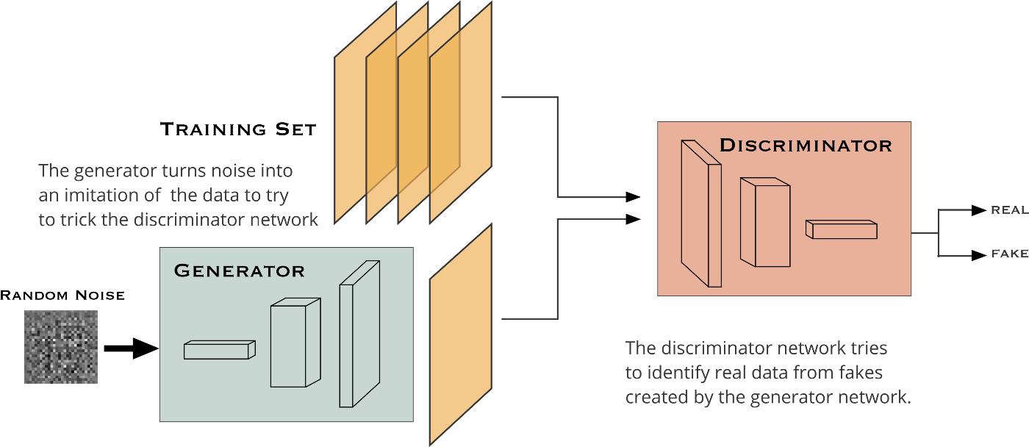
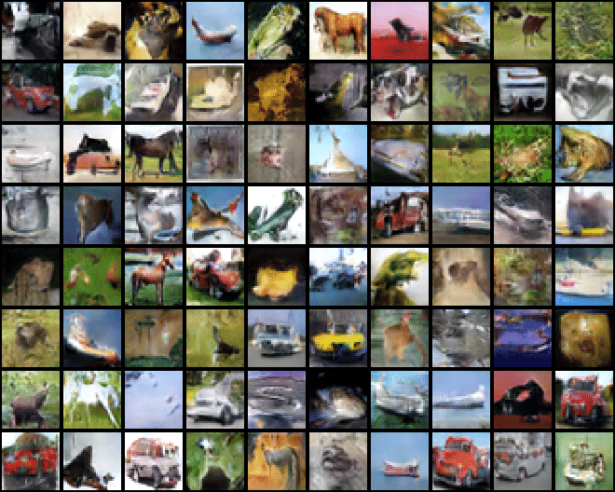
Generative Adversarial Networks
Model Creation for Cifar 10
Name: Aw Shao Yang
Class: DAAA/2B/03
Admission No: p2012126

Slide 2
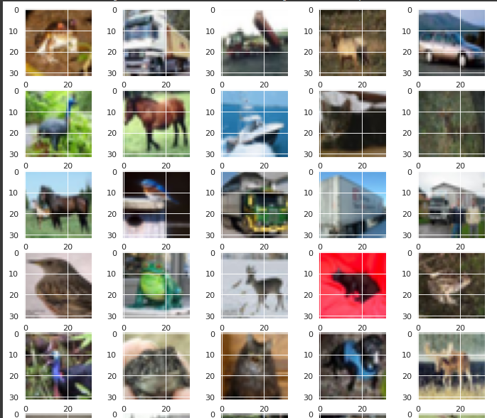

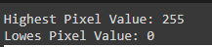
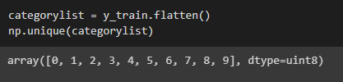
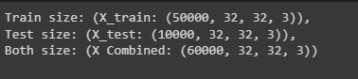
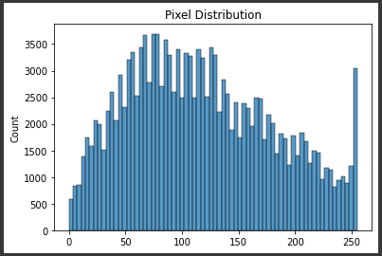
Data Exploration
Through data exploration here is what we have observed from the dataset
The RGB images of a total of 60,000. Since this is GANs and not purely CNN we can use all of the data in training
Dataset has 10 categories → our task would be to generate images similar to these 10 classes
Pixel distribution is between 0 ~ 255 for the 3 RGB channels
airplane
automobile
bird
cat
deer
Dog
frog
horse
ship
truck

Slide 3
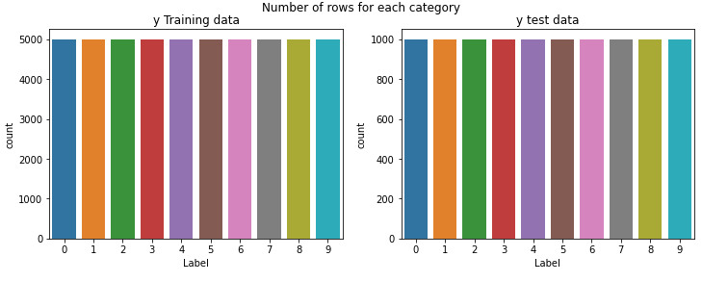
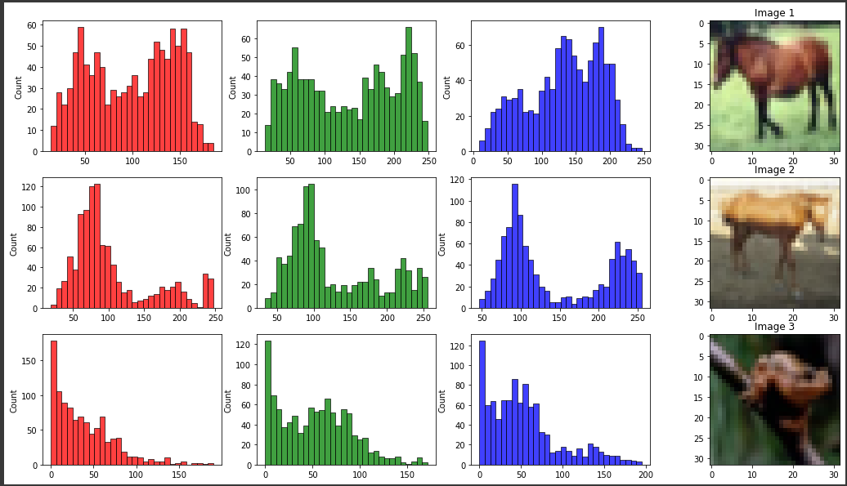
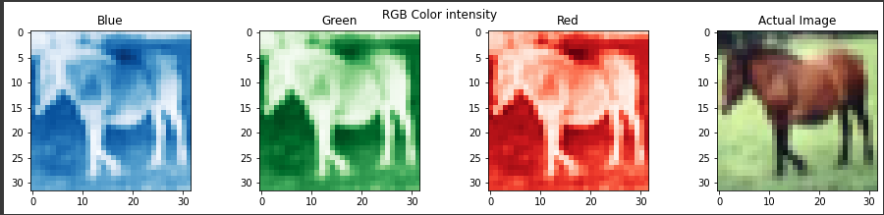
Data Exploration
Through data exploration here is what we have observed that:
The dataset classes are all equal in both train and test
The pictures have completely different pixel value distributions for the 3 RGB channel
Some appear to be skewed due to things like their backgrounds . While others have a normal distribution
RGB channels have some similarity in value distribution
We see that at certain areas, some colors are more intense than others.
We also notice that there are some areas where all 3 colors appear weak, indicating that part of the image may be of darker color and some areas that appear more intense, which may indicate lighter color

Slide 4
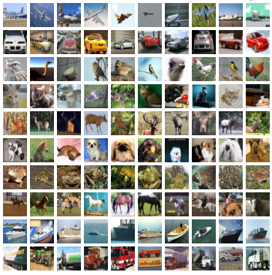

Model Development Summary
DCGAN 1 (Convergence Failure)
DCGAN 2 (Successful Base model)
DCGAN 3 (Upsampling vs Transpose 2D)
DCGAN 4 (Mode Collapse)
DCGAN 5 (Use of Inception Score)
WGAN (Wasserstein DCGAN)
CGAN (Conditional DCGAN)
Model Use on Separate Classes
Here is a quick summary of the model development progress, it includes:
Changes made from model performance observations
Alterations for model performance improvement
Changes made for better model evaluation
Final model creation and image evaluation

Slide 5
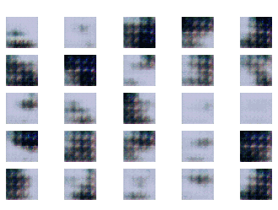
DCGAN 2 (Successful Base Model)
The first model that I will be going through is my 1st successful base model for DCGAN. The model was labelled as DCGAN 2 as it was optimized from my first model which was met with a Convergence Failure problem.
Model Architecture
Model Performance
Generator
Discriminator
Dense(4096) [ReLU]
Reshape((4,4,256))
Conv2DTrans(ker=4, str=2,pad=’same’)
BatchNorm(momentum=0.8)
Activation(ReLU)
X 3, nodes: 256 -> 128 -> 64
Conv2D(3,ker=3, pad=’same’)
Activation(Tanh)
Conv2D(ker=3, stride=2,pad=’same’)
Activation(LeakyReLU(alpha=0.2))
Dropout(0.2)
x4 , nodes: 32 ->64 -> 128 -> 256
Flatten()
Dense(1)
Activation(Sigmoid)
Optimizer(Adam(lr=0.0002, beta_l=0.5))
Loss(Binary Cross Entropy)
Epoch=150, n_batch = 128

Slide 6
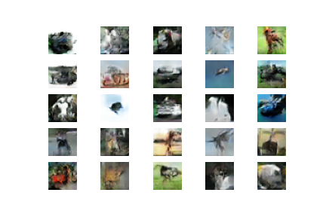
DCGAN 2 (Results)
From the model’s image results we see that:
Model was successful in generating images that are unique and look somewhat like certain categories in the training data
Problems like failure to converge and mode collapse are not present or very insignificant
Problems:
Images seem to have pixelated areas due to overlapping from Conv2D Transpose layer
It would seem training is not enough as quite a few images look weird

Slide 7
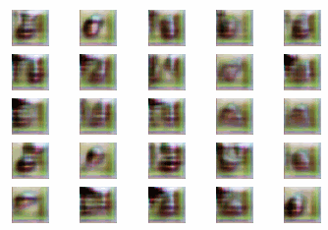
DCGAN 4 (Upsampling2D)
To combat against the overlapping pixel issues, I substituted the Conv2D Trans layers to the Upsampling 2D layers instead. However, more architecture alterations had also been done to deal with the problem of Mode Collapse
Model Architecture
Generator
Discriminator
Dense(4096) [LeakyReLU(0.1)]
Reshape((4,4,256))
Upsampling2D()
Conv2D(ker=4, pad=’same’)
BatchNorm(momentum=0.8)
Activation(LeakyReLU(0.1))
X 3, nodes: 128 -> 128 -> 128
Conv2D(3,ker=3, pad=’same’)
Activation(Tanh)
Conv2D(ker=4, stride=2, pad=’same’)
Activation(LeakyReLU(alpha=0.2))
Dropout(0.2)
x3 , nodes: 64 -> 128 -> 256
Flatten()
Dense(1)
Activation(Sigmoid)
Optimizer(Adam(lr=0.0002, beta_l=0.5))
Loss(Binary Cross Entropy)
IS Score: 3.2 ~ 4
We see that images now do not have the initial pixel overlap issue
Epoch=150, n_batch = 128

Slide 8
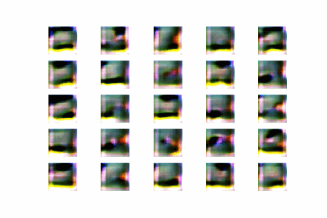
DCGAN 7 (Conditional DCGAN)
In order to create a conditional DCGAN model, we would need to introduce the prediction labels of the dataset into the model’s generator, discriminator and training. Hence there is change in the model architecture
Model Architecture
Generator
Discriminator
Input(shape=(1,))
Embedding(10, 50)
Dense (16)
Reshape((4,4,1))
Dense(4096) [ReLU]
Reshape((4,4,256))
Concatenate()
Upsampling2D()
Conv2D(ker=4, pad=’same’)
BatchNorm(momentum=0.8)
Activation(LeakyReLU(alpha=0.1))
X 3, nodes: 128 -> 128 -> 128
Conv2D(3,ker=3, pad=’same’ , ‘tanh’)
Input(shape=(1,))
Embedding(10, 50)
Dense(32x32)
Reshape((32,32,1))
Concatenate()
Conv2D(ker=4, str=2),pad=’same’)
Activation(LeakyReLU(alpha=0.2))
Dropout(0.2)
x4 , nodes: 32 ->64 -> 128 -> 256
Flatten()
Dense(1)
Activation(Sigmoid)
Optimizer(Adam(lr=0.0002, beta_l=0.5))
IS Score: 3.2 ~ 4
We see that the model had similar performance in terms of IS score, however from visual judgment, the model was able to generate more obvious images for certain categories

Slide 9
DCGAN (Model Use On Separate Classes)
Lastly I have decided to try image generation with individual classes, to see if there would be any improvement by only training 1 class at a time. However I was not able to compare using IS scores as they are only single category
Model Architecture
Model Performance
Generator
Discriminator
By just training on individual classes, there was improvement in the model’s image generation. And the images are clearer in terms of what category they are supposed to be
I have decided to train the individual models all on 270 epochs as most of them seemed done on 270 epochs
Dense(4096) [ReLU]
Reshape((4,4,256))
Upsampling2D()
Conv2D(ker=4, pad=’same’)
BatchNorm(momentum=0.8)
Activation(ReLU)
X 3, nodes: 128-> 128 -> 128
Conv2D(3,ker=3, pad=’same’)
Activation(Tanh)
Conv2D(ker=3, pad=’same’)
Activation(LeakyReLU(alpha=0.2))
Dropout(0.2)
X3 , nodes: 64 -> 128 -> 256
Flatten()
Dense(1)
Activation(Sigmoid)
Optimizer(Adam(lr=0.0002, beta_l=0.5))
Loss(Binary Cross Entropy)

Slide 10
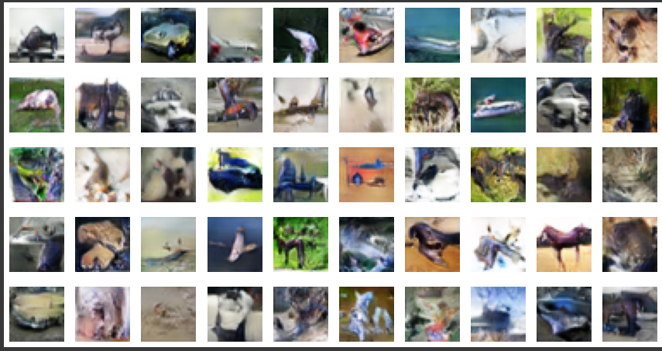
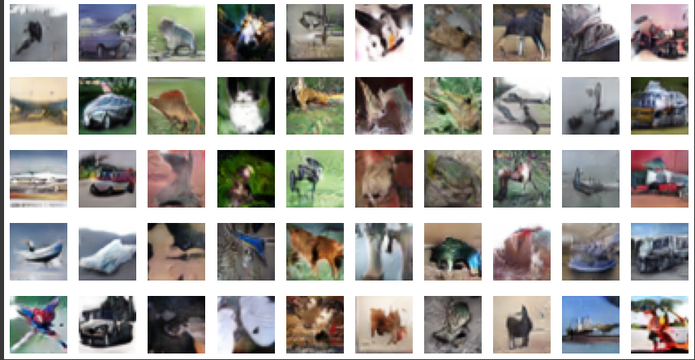
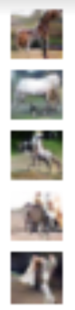
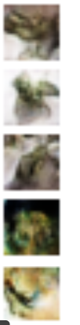
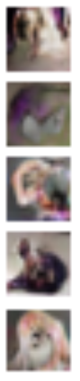
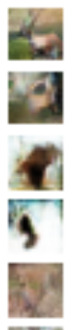
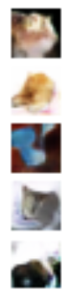

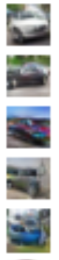
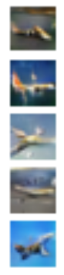
DCGAN (Model Comparison and Evaluation)
DCGAN 4 (Upsampling)
Conditional DCGAN
DCGAN (individual classes)
Images are unique and do have some classes where the images were clear and obvious on what they were, such as frog and ships.
Images are random and are unable to be selected
IS Score : 3.2 ~ 4
Through the use of a Conditional DCGAN model we are now able to select the classes that we want to generate. There was also some improvements to the image quality, for classes such as automobile, trucks and planes
IS Score: 3.2 ~ 4
This has been chosen as my final model
We see a significant increase in the image quality for all classes, however we lose the ability to predict multiple categories with just 1 model.
This was just an experimentation with DCGAN and will not be my final model.

